Slide 1
FireWork vs CFFEPS
Prepared by: Elisa Dong
April 16, 2018

Slide 2
Goals
Compare operational FireWork and CFFEPS (in development) models indirectly by comparing to model plumes to MINX digitized plumes
Analyze commonalities and difficulties
Discuss potential issues when doing comparisons

Slide 3
Scope
Location: Canada
Dates: Apr 1, 2017 – Oct 31, 2017
Satellite Timing: matched to MISR overpasses (expected pass over frequency is 2-9 days for the same area)
FirePower: Will be discussing plumes with total FRP at 95th percentile of the FirePixels
Notes:
FRP: Fire Radiance Power
FirePixels: downloaded when running preMINX to get data on potential fires in advance to digitization

Slide 4
Expectations
CFFEPS should show more variation in plume height than FireWork
General underestimation for model plume height based on height retrieval method
Notes:
Get explanation for increased variation in CFFEPS from jack. Something about distribution of emissions

Slide 5
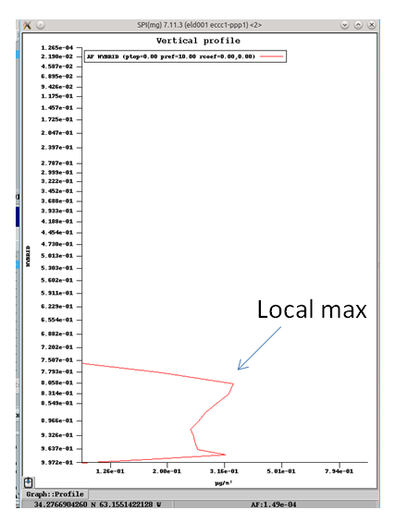
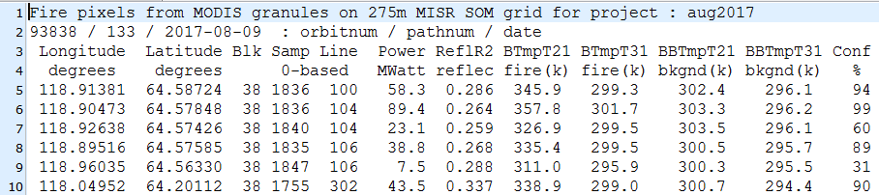
Plume Retrieval
MINX Plume Digitize fire plumes using MINX4 software
Download data using preMINX (MODIS and MISR data)
Reduce number of FirePixels from MODIS to look at using confidence levels, 50th percentile in FRP
Digitize plumes, only keep ‘fair’ and ‘good’ plumes
Model Plume Find corresponding plumes in models using local maxima of PM2.5 (AF)
Models are CFFEPS and FireWork, with anthropogenic sources (GEMMACH) of PM2.5 removed
Height of local maximum of PM2.5 is considered ‘model plume height’ for each point in the ‘MINX plume’
Notes:
NOTE: the FRP percentile doesn’t actually mean much, given that some plumes have several FirePixels and result in very large FRPs. Was just useful way of reducing total number of plumes. It is likely that the plumes with FRP greater than a given percentile are bigger (or simply have more contributing fires) than the ones filtered out

Slide 6
Processing
Compare Model to MINX plume by
Percentile, filtered out plumes by total FRP
Biome, category assigned to plumes by MINX
Fuel, factor in producing CFFEPS/FireWork results
Distance, more detailed look at plume movement/prediction in model
Notes:
NOTE: For CFFEPS, took out 5 plumes in the total plumes from the 50th percentile that were outliers

Slide 7
Summary
CFFEPS
FireWork
Minimum FRP (MWatts), 242.8
Plumes Processed, 132
Number of Valid Pairs, 8306
Number of Dropped Pairs, 4338
MINX Plume Max, 7289.0
Model Plume Max, 5304.37207031
MINX Plume Min, 322.0
Model Plume Min, 259.284057617
MINX Plume Mean, 2700.13544426
Model Plume Mean, 1794.36097133
RMSD, 1676.44958583
Pearson Correlation Coefficient, pValue, (0.18372308460723186, 5.7608014734195236e-64)
R Squared, pValue, (0.033754171817596088, 5.7608014733632697e-64, 'y = 0.168225401982x + 1340.12960082')
Mean Absolute Percent Error, 57.6920827408
Mean Percentage Error, 18.9603077187
Minimum FRP (MWatts), 242.8
Plumes Processed, 135
Number of Valid Pairs, 7956
Number of Dropped Pairs, 5173
MINX Plume Max, 8759.0
Model Plume Max, 4290.00292969
MINX Plume Min, 322.0
Model Plume Min, 264.284057617
MINX Plume Mean, 2701.59401709
Model Plume Mean, 1452.71418214
RMSD, 1670.89049948
Pearson Correlation Coefficient, pValue, (0.46646400330864857, 0.0)
R Squared, pValue, (0.21758866638273117, 0.0, 'y = 0.371889746822x + 448.019067103')
Mean Absolute Percent Error, 50.6477952174
Mean Percentage Error, 42.5201822742
Notes:
Bolded are results that show CFFEPS is performing better than FireWork on an individual point by point basis
Italicized are results that show FireWork is performing better overall (higher correlation coefficients, line of best fit is closer to ideal)
On point by point basis, seems like CFFEPS has improved

Slide 8
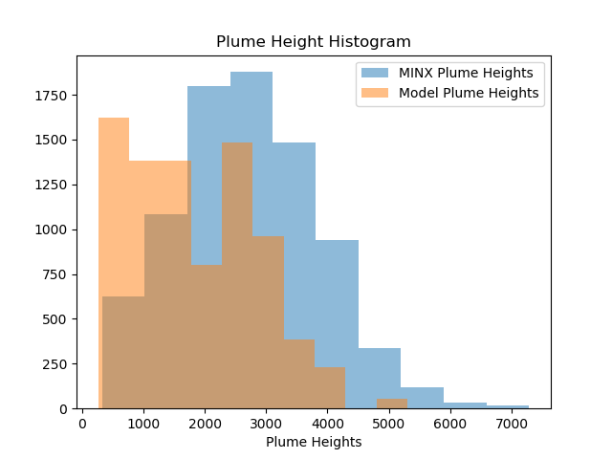
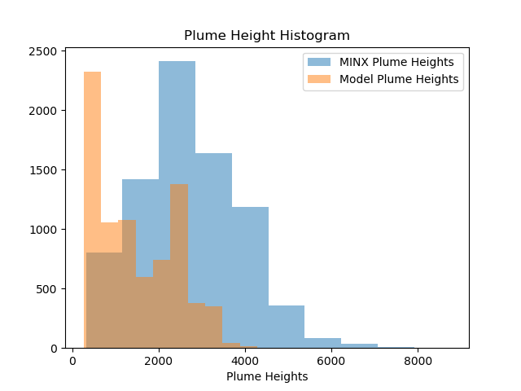
Summary – Height Histogram
CFFEPS
FireWork
Notes:
See that the plume height histogram is more closely matched by CFFEPS than for FireWork. Both seem to be underestimating.
In particular, there are fewer numbers of very low plume heights in the CFFEPS results.
Note that the points here are not one-to-one, but of the points retrieved from CFFEPS and FireWork respectively that match up to MINX plume points. Ie. There is not a CFFEPS point for each FW point.
Will submit argument for using height histograms here:
Since the total number of points is very high (thousands), seeing them plotted on point by point basis may not be very helpful. Instead, we can see if the heights retrieved from the model are close to the height distribution from MINX, and this should give us a general idea of the model performance.

Slide 9
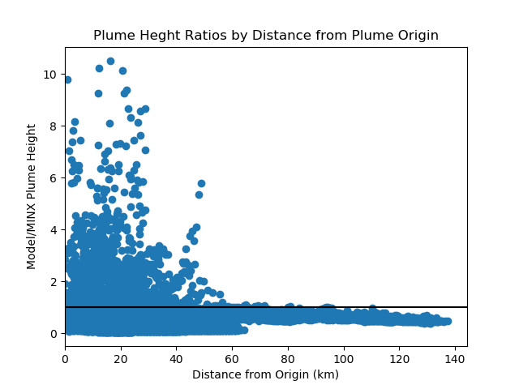
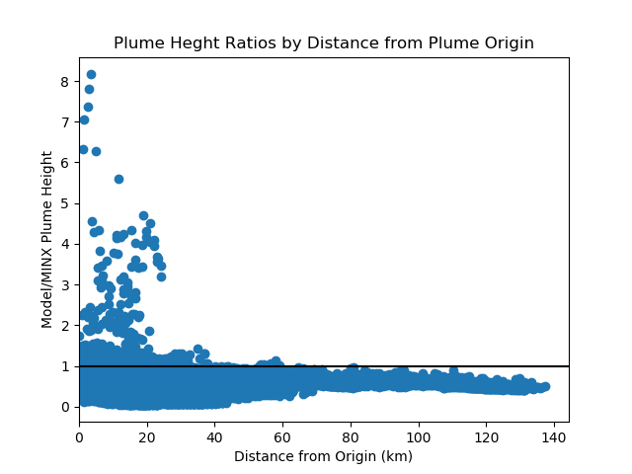
Summary – Ratios by Distance
CFFEPS
FireWork
Notes:
Ignore typo in title. Is fixed for future program use.
FireWork – we see a lot underestimation for plumes > 60km in length. Closer is unclear, but there is more variation and definitely some overestimation near origin
CFFEPS – similar in seeing underestimation in plumes > 60km in length. Also seeing a lot more overestimation/variation for points less than 60km away.
Too many points to see clearly, next is breaking down by distance

Slide 10
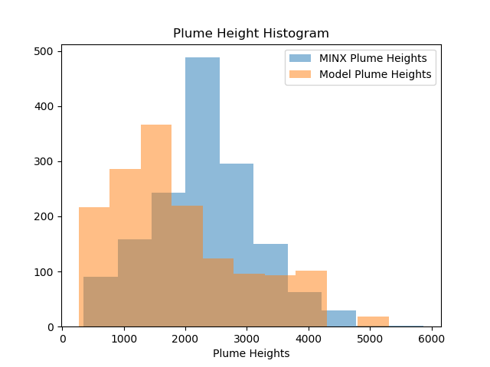
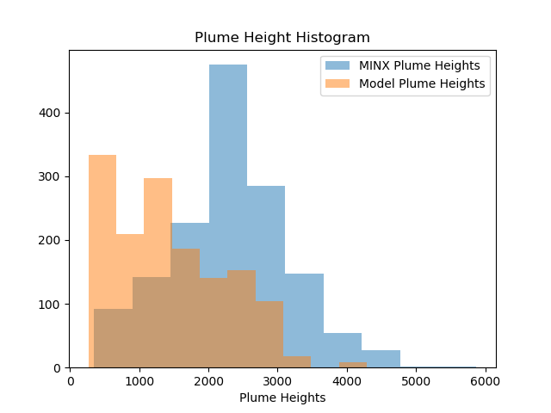
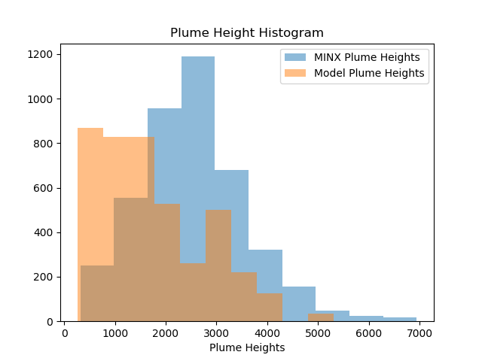
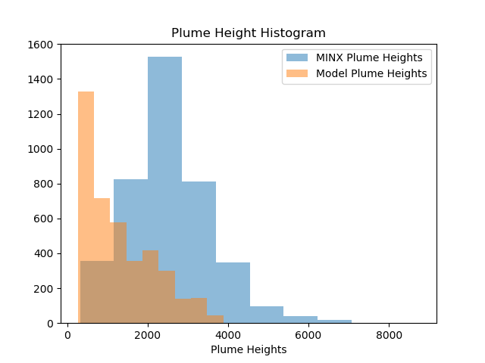
Close to the Origin – 0-30km
CFFEPS
FireWork
Notes:
Top: 0-10 km
Bottom: 10-30km
Generally see that CFFEPS fits better for this range. Note that scatter plots are super densely packed, can’t actually see much by looking at them

Slide 11
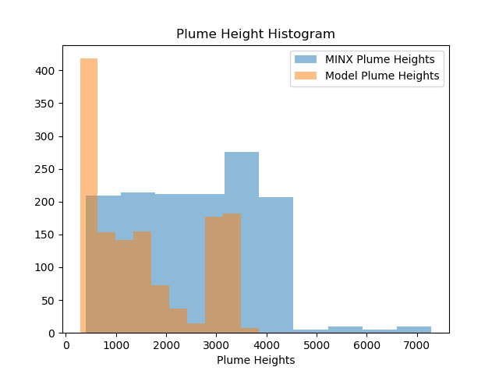
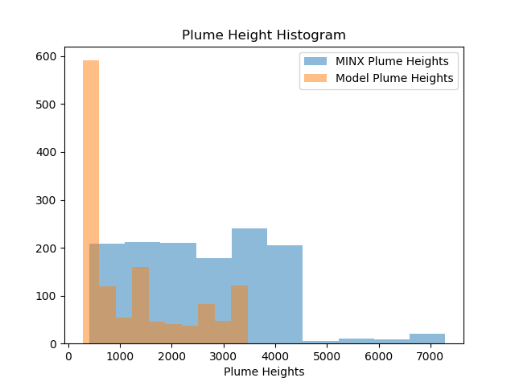
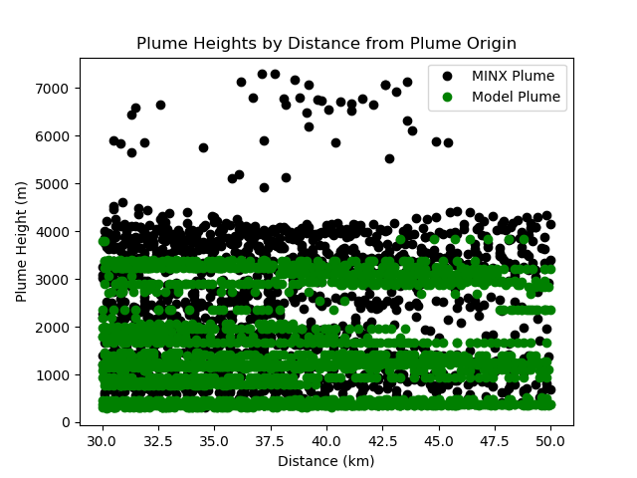
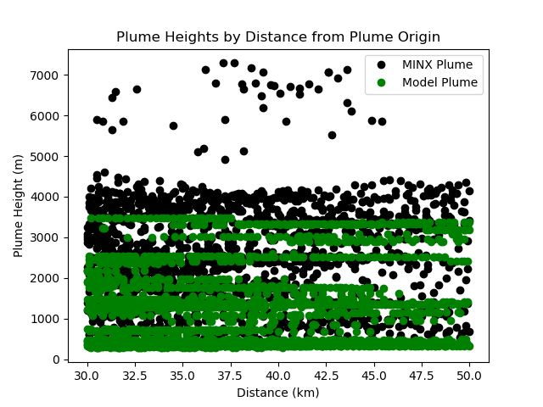
30-50km from the Origin
CFFEPS
FireWork
Notes:
Farther from the origin, we see that both are underestimating, and missing out the higher plume points completely.
Difficult to see which is performing better, but distribution appears to be better for CFFEPS.

Slide 12
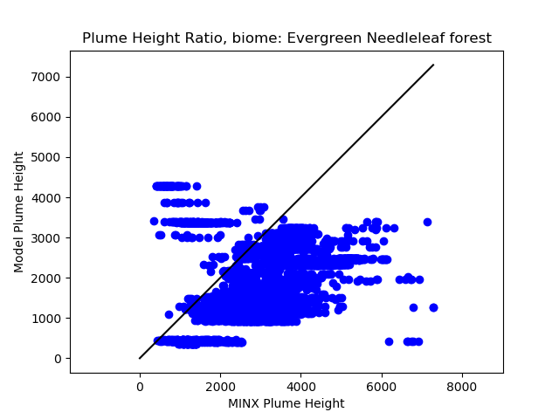
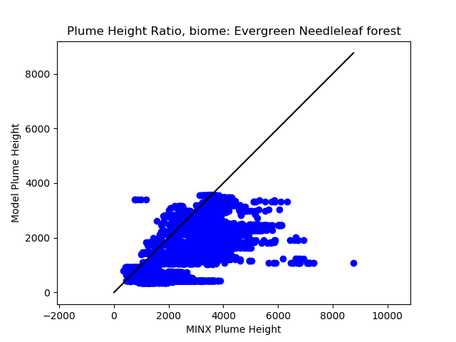
Breakdown by Biome – Evergreen Needleleaf
CFFEPS
FireWork
Notes:
Only showing biomes with lots of points
Evergreen Needleleaf has CFFES showing overestimation for some lower MINX plume heights (these points are usually near the origin)

Slide 13
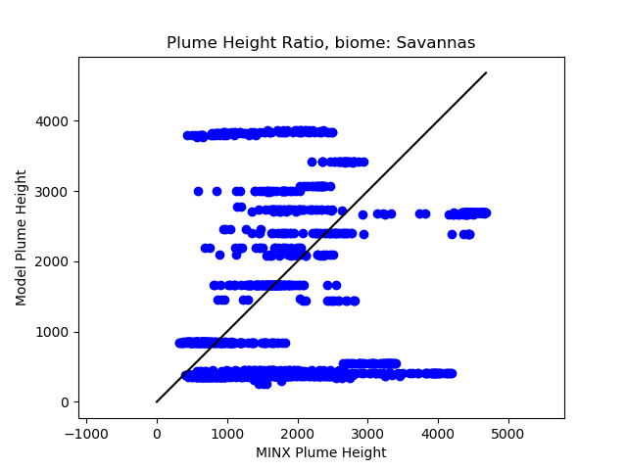
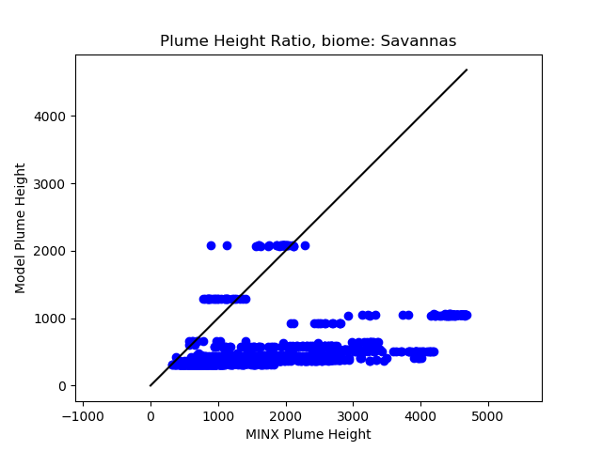
Breakdown by Biome – Savannas
CFFEPS
FireWork
Notes:
More variation in CFFEPS results.
For FireWork, results in mostly low-lying plumes

Slide 14
Breakdown by Fuel
CFFEPS appears to show improvement for fuel types
102, Boreal Spruce
108, Leafless Aspen
FireWork appears to be slightly better than CFFEPS for fuel types
103, Mature Jack or Lodgepole Pine
105, Red and White Pine

Slide 15
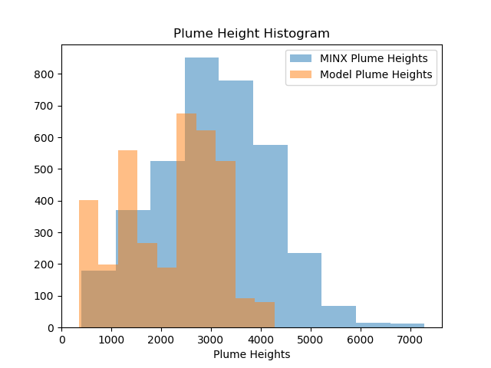
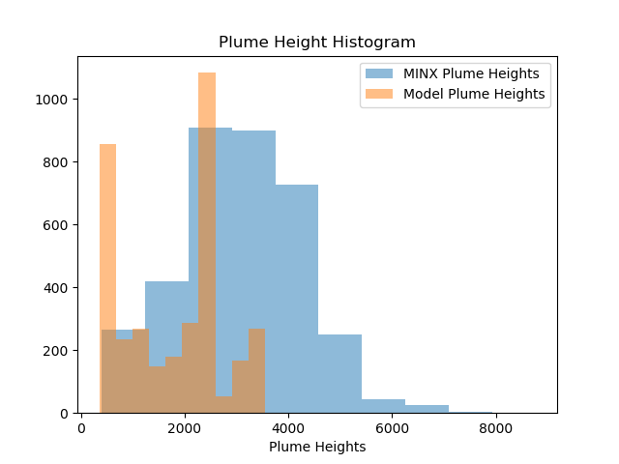
Breakdown by Fuel – 102
CFFEPS
FireWork
Notes:
CFFEPS looks better than FireWork when it comes to distribution. Unclear when it comes to stats (next slide)

Slide 16
Breakdown by Fuel – 102 (stats)
CFFEPS
FireWork
Plumes Processed, 34
Number of Valid Pairs, 3612
Number of Dropped Pairs, 1338
MINX Plume Max, 7289.0
Model Plume Max, 4274.22167969
MINX Plume Min, 406.0
Model Plume Min, 345.535583496
MINX Plume Mean, 3053.02104097
Model Plume Mean, 2159.52598138
RMSD, 1711.09573524
Pearson Correlation Coefficient, pValue, (0.084932697237471516, 3.1890131980560716e-07)
R Squared, pValue, (0.0072135630600319777, 3.1890131980565073e-07, 'y = 0.0731363413759x + 1936.23919229')
Mean Absolute Percent Error, 60.8510928881
Mean Percentage Error, 10.7721449162
Plumes Processed, 35
Number of Valid Pairs, 3546
Number of Dropped Pairs, 1691
MINX Plume Max, 8759.0
Model Plume Max, 3548.41259766
MINX Plume Min, 406.0
Model Plume Min, 352.427062988
MINX Plume Mean, 3078.26508742
Model Plume Mean, 1751.55249762
RMSD, 1650.86313983
Pearson Correlation Coefficient, pValue, (0.60412567848928944, 0.0)
R Squared, pValue, (0.36496783541014433, 0.0, 'y = 0.495821472837x + 225.28256819')
Mean Absolute Percent Error, 45.407481062
Mean Percentage Error, 42.6094661389
Notes:
Is harder to judge when looking at stats. Looking at mean percentage error, seems to have improved.

Slide 17
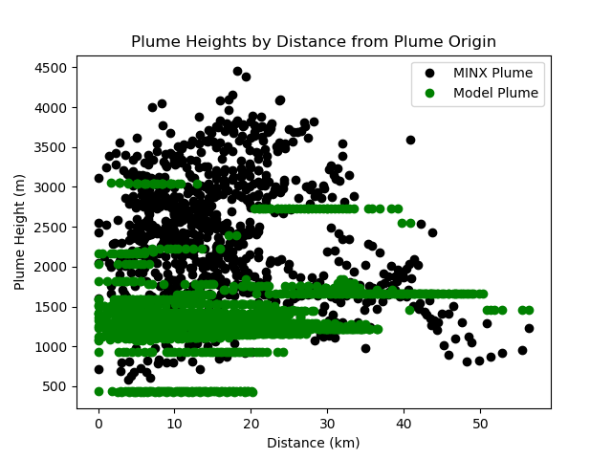
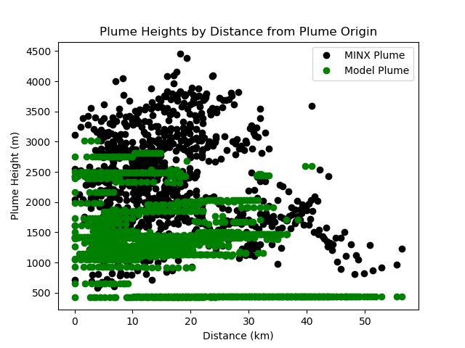
Breakdown by Fuel - 103
CFFEPS
FireWork
Notes:
FireWork has a few plumes in the 2000-2500m range that is better represented.

Slide 18
Breakdown by Fuel – 103 (stats)
CFFEPS
FireWork
Plumes Processed, 20
Number of Valid Pairs, 913
Number of Dropped Pairs, 533
MINX Plume Max, 4451.0
Model Plume Max, 3057.21386719
MINX Plume Min, 578.0
Model Plume Min, 422.843933105
MINX Plume Mean, 2367.7305586
Model Plume Mean, 1382.66916144
RMSD, 1278.31448388
Pearson Correlation Coefficient, pValue, (0.20426155063092258, 4.6858456003726221e-10)
R Squared, pValue, (0.041722781066148934, 4.6858456003689639e-10, 'y = 0.119824333894x + 1098.95742442')
Mean Absolute Percent Error, 42.8929267365
Mean Percentage Error, 36.0365911084
Plumes Processed, 20
Number of Valid Pairs, 915
Number of Dropped Pairs, 531
MINX Plume Max, 4451.0
Model Plume Max, 3020.01904297
MINX Plume Min, 578.0
Model Plume Min, 421.631469727
MINX Plume Mean, 2369.70491803
Model Plume Mean, 1343.89194056
RMSD, 1265.39483596
Pearson Correlation Coefficient, pValue, (0.46531774799706566, 2.3753347002428403e-50)
R Squared, pValue, (0.21652060660106065, 2.3753347002424519e-50, 'y = 0.383803161156x + 434.391702011')
Mean Absolute Percent Error, 44.9585193129
Mean Percentage Error, 40.7427691546
Notes:
Stats show that there isn’t much difference between the two results on average, but correlation is definitely better for FireWork and shows up in all plots
Perhaps the model for this fuel could be improved

Slide 19
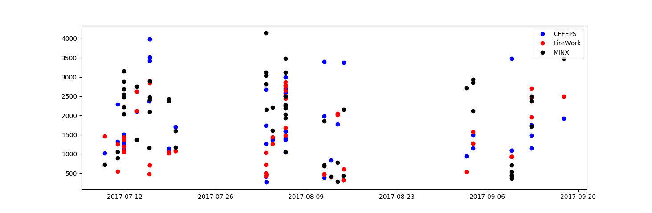
Time Series – Origin Points
Notes:
Note: since the origin points were cleaned (needed a point for MINX, FW AND CF), not that many points.
Somewhat ambiguous looking image. Note that on days with a lot of plumes, CFFEPS has a tendency to have higher values.
Most overestimations do come from CFFEPS (clear, single points fairly high up).

Slide 20
Case Studies
5 plumes removed from CFFEPS plumes for having heights over 20000m
Cluster of plumes in one area, overlapping each other

Slide 21
Case Study – 20k+ heights
Date: June 2, 2017
Location: Yukon Territory
Reason for Case Study:
These plumes resulted in model plume heights of over 20000m in CFFEPS
High plume heights skewed CFFEPS results and were clear outliers
Investigating why these plumes show up at such heights, but are somewhat reasonable in FireWork results

Slide 22
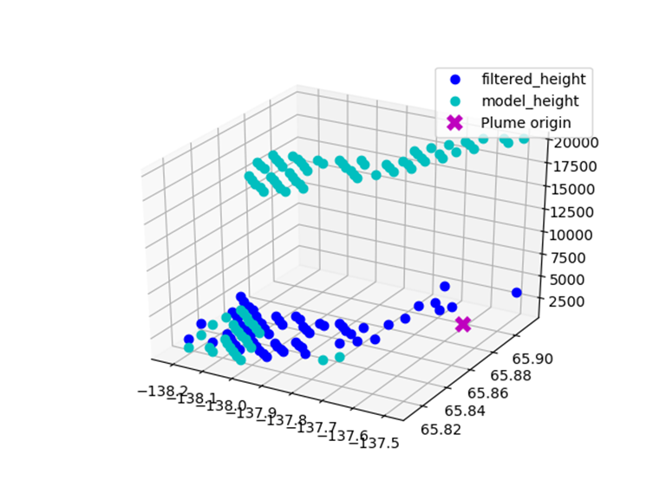
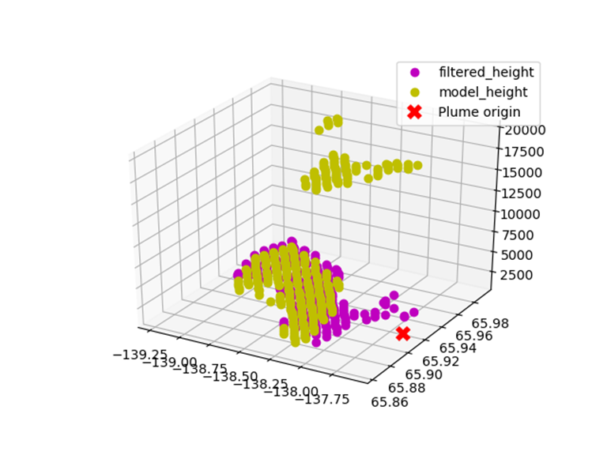
Case Study – 20k+ heights
Results:
Local maxima for PM2.5 values were found to be average of 5.9ppm (very low)
Possible that PM2.5 values are indicative of another plume or another source that are not part of the plume we’re looking at
Two plumes show this possibility clearly:
Part of model plume matches the MINX plume height closely
Other part of model plume is much higher and looks to be part of a different source
Notes:
PM2.5 values that were defining the height of the plume were very low, likely to be from other source of fire not from the plumes we’re looking at
Reasonable to discard these 5 plumes when doing analysis

Slide 23
Case Study – Overlapping Plumes
Date: Sept 3, 2017
Location: BC/AB/USA border
Reason for Case Study:
Check how MINX/model performs for overlapping plumes

Slide 24
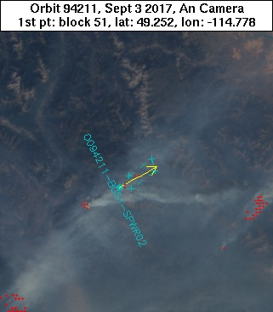
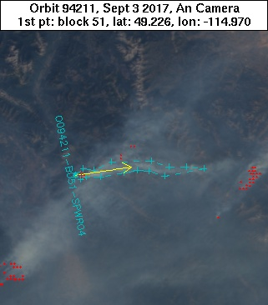
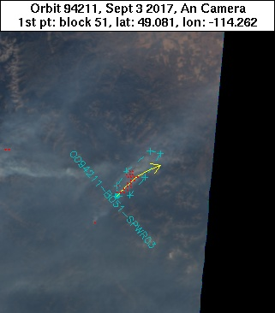
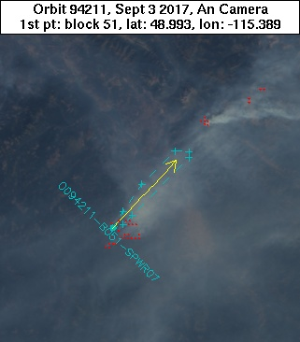
Case Study – Overlapping Plumes
Notes:
Can see that these plumes will likely have lots of interference from other source of smoke.
Digitization – was careful to outline the plumes as far was obvious the smoke was belonging to the same plume

Slide 25
Case Study – Overlapping Plumes
Results:
Both CFFEPS and FireWork model heights are similar and underestimate the plume heights
Can see potential interference from other plumes
Also possible that ‘jumps’ in model height are due to vertical resolution in model

Slide 26
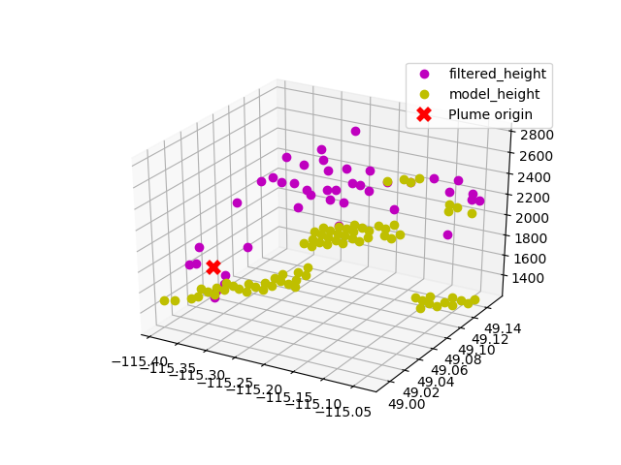
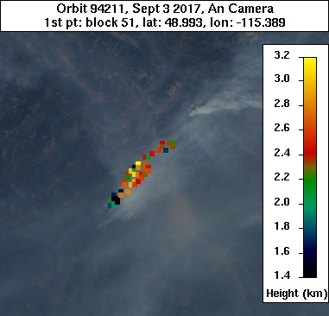
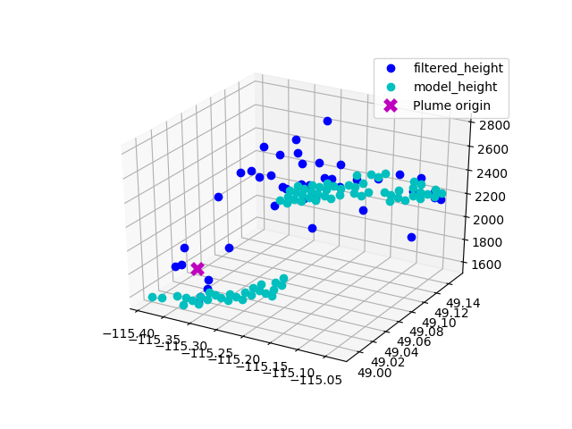
Case Study – Overlapping Plumes
One plume with some differences between CFFEPS and FireWork
CFFEPS(left) shows a split near the tail end of the plume, possible interference from another plume
FireWork does not suffer from this
Notes:
NOTE: earlier had concern with low PM2.5 values allowing for interference
Did not check PM2.5 values, for CFFEPS in general. Perhaps is why CFFEPS has visually lower plumes heights for long plumes, possible a lot of that is from interfering plumes?

Slide 27
Notes - Plumes
MINX plumes
User Digitization: Ideally the more plumes digitized, the less issues we have from the user preferences/interpretation
Plume Heights: Other options other than ‘filtered_height’ to be using. Median height may suit current model plume height detection better
Model plumes
Threshold: 0ppm May be getting artifacts or PM2.5 values from other sources than the plume Setting higher may reduce overall points, but can reduce false plume points
Resolution: 10km grid (horizontal resolution) A few hundred meters between layers (vertical resolution). Unsurprising we’re seeing underestimation for points farther away from origin if picking out the densest parts of the plume
Distance/Shape of Plume: Other than emission data, meteorological data is the same General shape/movement of plume is expected to be the same

Slide 28
Notes – Source Data and Classification
MISR satellite:
Infrequent overpasses at 10:30am
Miss development of fire
Miss peak fire growth time
Classifications:
Distance Distances were picked arbitrarily to showcase chunks of plumes Unsure if ‘distance’ is lateral distance or includes vertical distance
Biomes Based on MINX results, categories may be too broad to consider impact of classification
Fuels Based on inputs to CFFEPS/FireWork Some results indicate fuel type (where origin is) is water. Indicates possibility that MINX lon/lat of origin may be slightly off

Slide 29
Conclusion
Some improvements from FireWork to CFFEPS
More variability for close to origin (as expected) for CFFEPS plume heights, though lots of overestimation as well
Model suffers from being unable to distinguish plumes with overlapping
May need to find better way to get plume from model (MINX uses top-down approach)
Need additional statistical methods to quantify ‘goodness’ of results, correlation coefficients do not represent the overall results well

Slide 30
Next Steps
Use CALIOP retrieval data to compare to model plumes
Potentially come up with better plume height retrieval method for model (especially since there are hundreds of meters between vertical layers)

Slide 31
Results
https://hpfx.science.gc.ca/~eld001/MINXResults/FW-GM_start00/ops_postCanFilt/plumeApr_Oct/
https://hpfx.science.gc.ca/~eld001/MINXResults/CF-GM_start00/ops_postCanFilt/plumeApr_Oct/
Notes:
Results for FireWork and CFFEPS

